Slide 1

EXPLORATORY DATA ANALYSIS
G2M INSIGHT FOR CAB INVESTMENT
18TH OF APRIL 2024

Slide 2

AGENDA
Executive Summary
Problem Statement
Approach
EDA
EDA Summary
Recommendations

Slide 3
EXECUTIVE SUMMARY
The US cab industry is at the cornerstone of transportation services throughout the different cities of the country, serving millions of persons on a daily basis. It is known for its widespread availability, adherence to road safety rules and regulated pricing.
As of 2012 the total number of taxi cab drivers in the United States is 233,900 and the expected percent job increase over the next 10 years is 16% which ties directly to profit/revenue generation.
In the light of this, there exists an investment opportunity for individuals or firms willing to capitalize in this expected boom in profit.
Our Client, XYZ, a private firm in US. Due to remarkable growth in the Cab Industry in last few years and multiple key players in the market, it is planning for an investment in Cab industry and as per their Go-to-Market(G2M) strategy they want to understand the market before taking final decision.

Slide 4
PROBLEM STATEMENT
As the Data analyst in charge of this project, the objective of the project remains to provide actionable insights to help XYZ firm in identifying the right company for making investment through the use of exploratory data analysis

Slide 5
APPROACH
After obtaining the datasets to be used, the following approach was necessary
Source documentation review
Exploratory Data Analysis (Profit & Users)
Profit & Users Forecast
Recommendations

Slide 6
SOURCE DOCUMENTATION REVIEW
The dataset contains four different csv files. These datasets were combined in the 'all_data.csv' file after reviewing.
Cab_Data.csv : This file includes details of transactions for 2 cab companies (9 features).
Customer_ID.csv : This is a mapping table that contains a unique identifier that links the customer’s demographic details (4 features).
Transaction_ID.csv : This is a mapping table that contains transaction to customer mapping and payment mode (3 features).
City.csv: This file contains a list of US cities, their population, and the number of cab users (3 features).

Slide 7
SOURCE DOCUMENTATION REVIEW
ASSUMPTIONS
Outliers are present in Price_Charged feature but due to
unavailability of trip duration details ,we are not treating this as outlier.
Profit was calculated using Price_Charged and Cost_of_Trip.
Users feature of city dataset is treated as number of cab users in the city. we have assumed that this can be other cab users as well(including Yellow and Pink cab).
LIMITATION
Information about the number of cabs owned by each company wasn’t given. The availability of that information would led to a more accurate result.
ANALYSIS
Analysis was based on two key metrics
Profit
Number of Users/Customer base i.e Users.

Slide 8
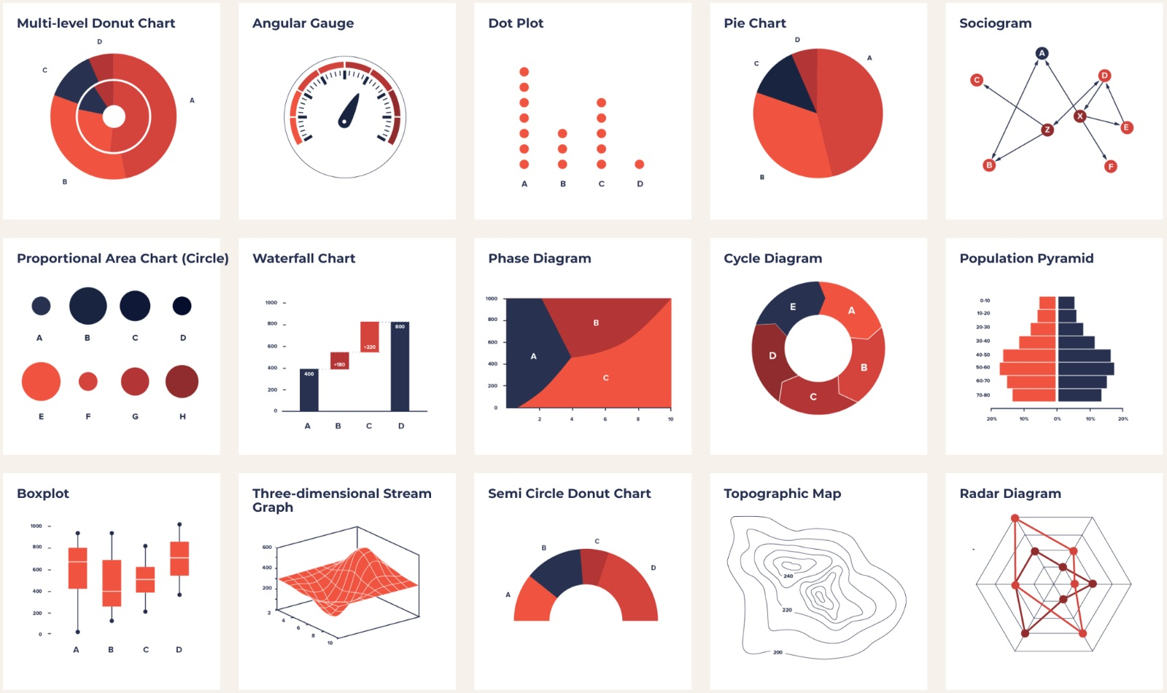
EXPLORATORY
DATA
ANALYSIS
(PROFIT & USERS)
This Photo by Unknown Author is licensed under CC BY-SA

Slide 9

PROFIT ANALYSIS

Slide 10
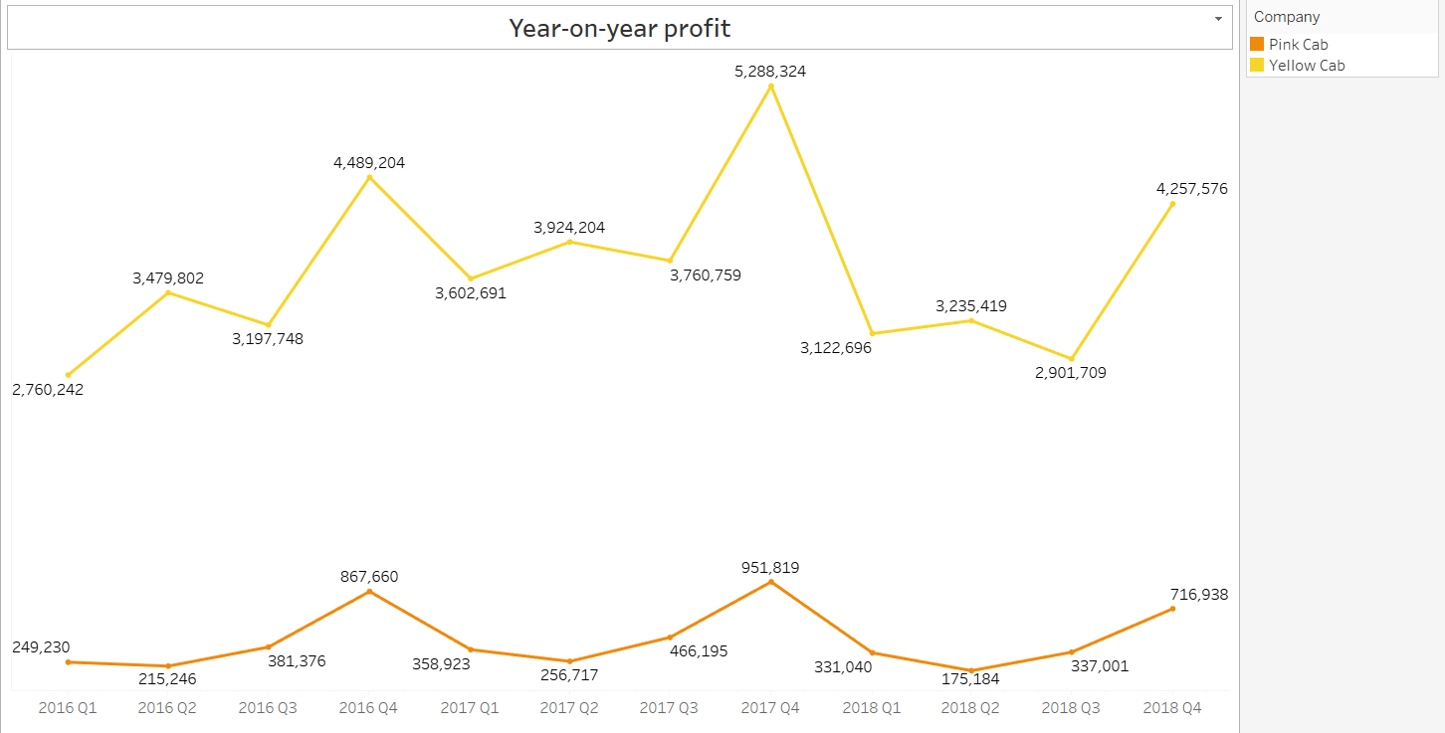
PROFIT BY QUARTERS
Analysis showcased a rise in profit for in the forth quarter of every year analyzed for both cab companies.
There exist a (80-95)% difference in profit figures for both companies with the Yellow cab company making more profits.
A decline in profit figures in the 3rd Quarter which recovers in the 4th Quarter for every year for the Yellow cab company.
The Pink cab company registered the lowest profit in the 2nd Quarter of each year which recovers in the 3rd and 4th Quarter

Slide 11
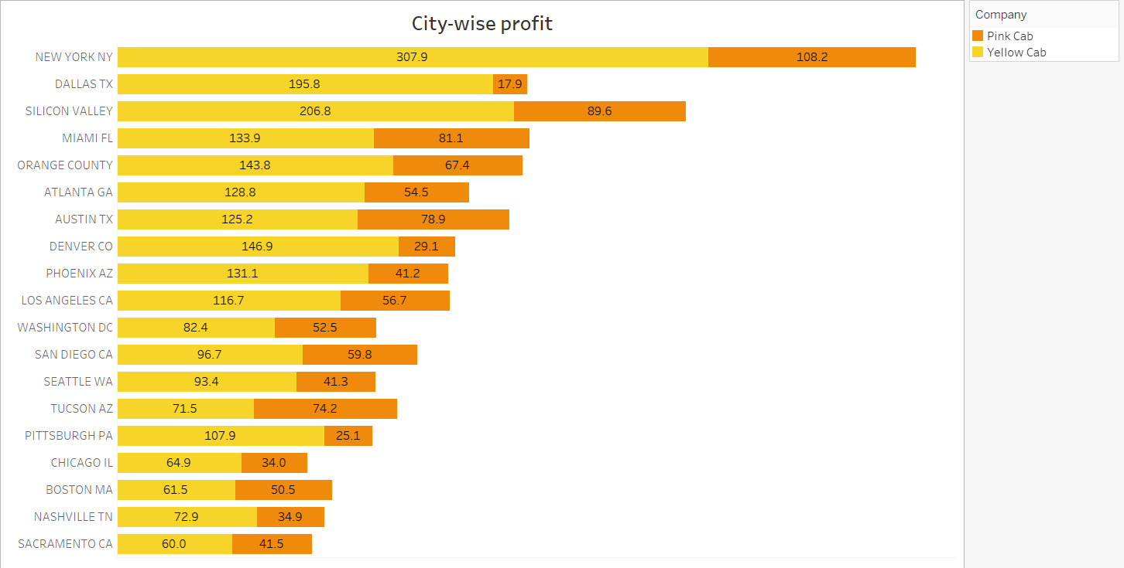
PROFIT BY CITY
The Yellow cab company had the highest average profit for Eighteen (18) of the Nineteen (19) cities analyzed.
The Pink cab company only had a slightly higher profit average-wise in Tucson Arizona.

Slide 12
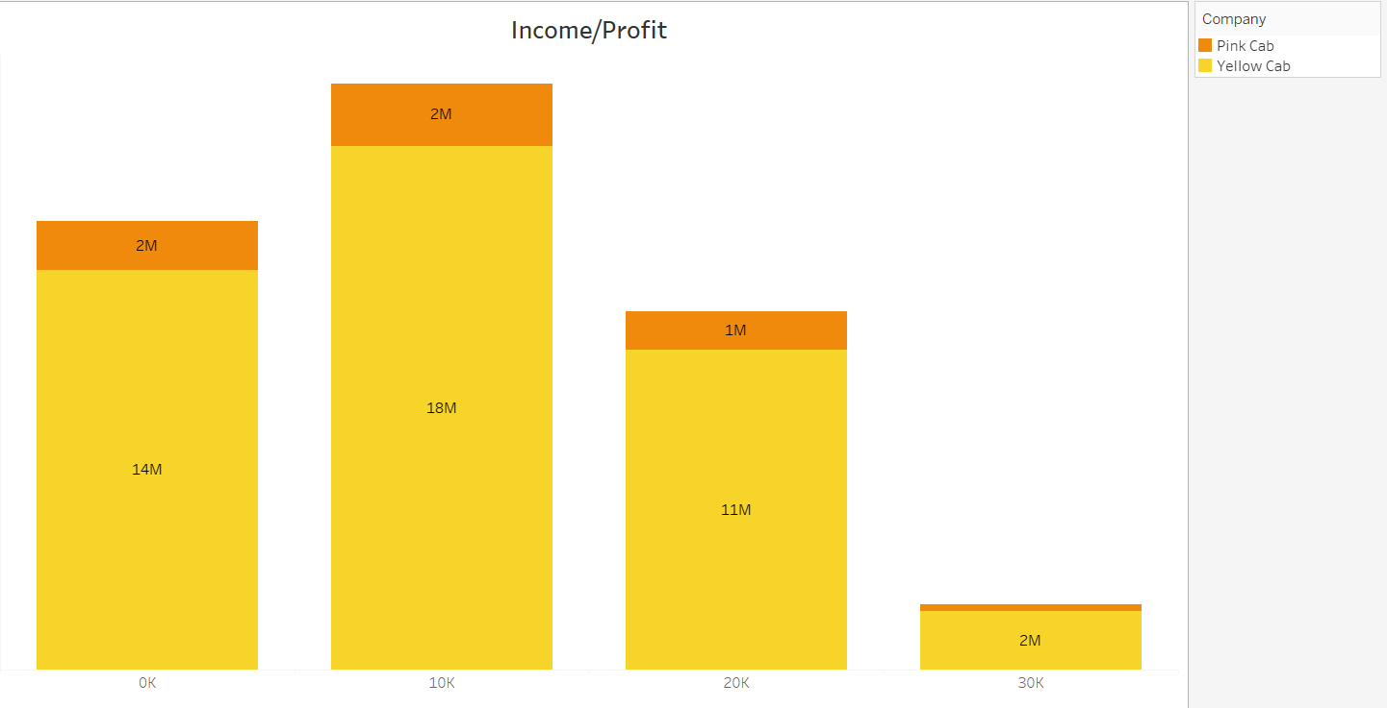
INCOME-PROFIT ANALYSIS
Highest profit figures ensued from users who made between 10k-20k followed by users who made less than 10k monthly.
The lowest profit were from high income individuals.
The Yellow cab company had higher profits across all income earning categories.

Slide 13
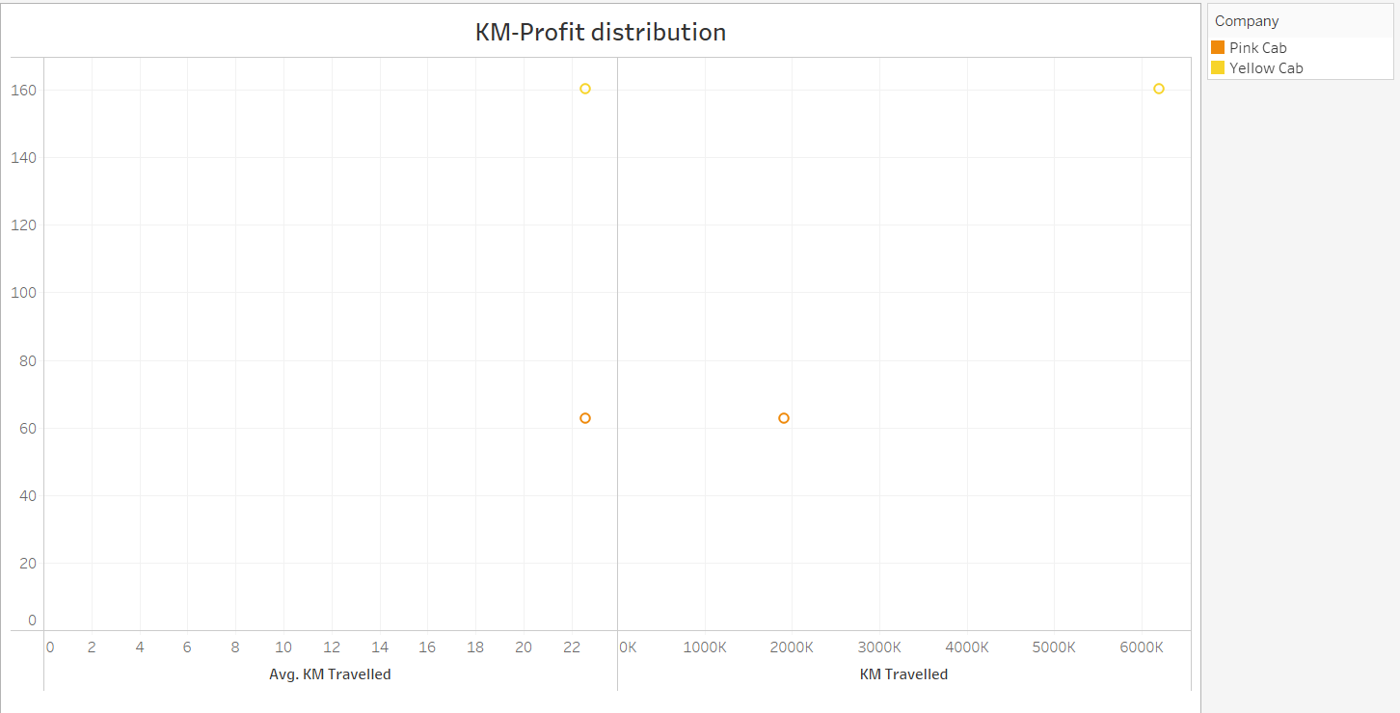
PROFIT BY DISTANCE COVERED
Analysis showed that both companies had relatively similar distance travelled on a average.
While the Yellow cab company had a cumulative distance covered of over 6000k Kilometers, the Pink company recorded a little less than 2000k kilometers.
Yellow cab made far more profit than their counterpart by average and total distanced covered.

Slide 14
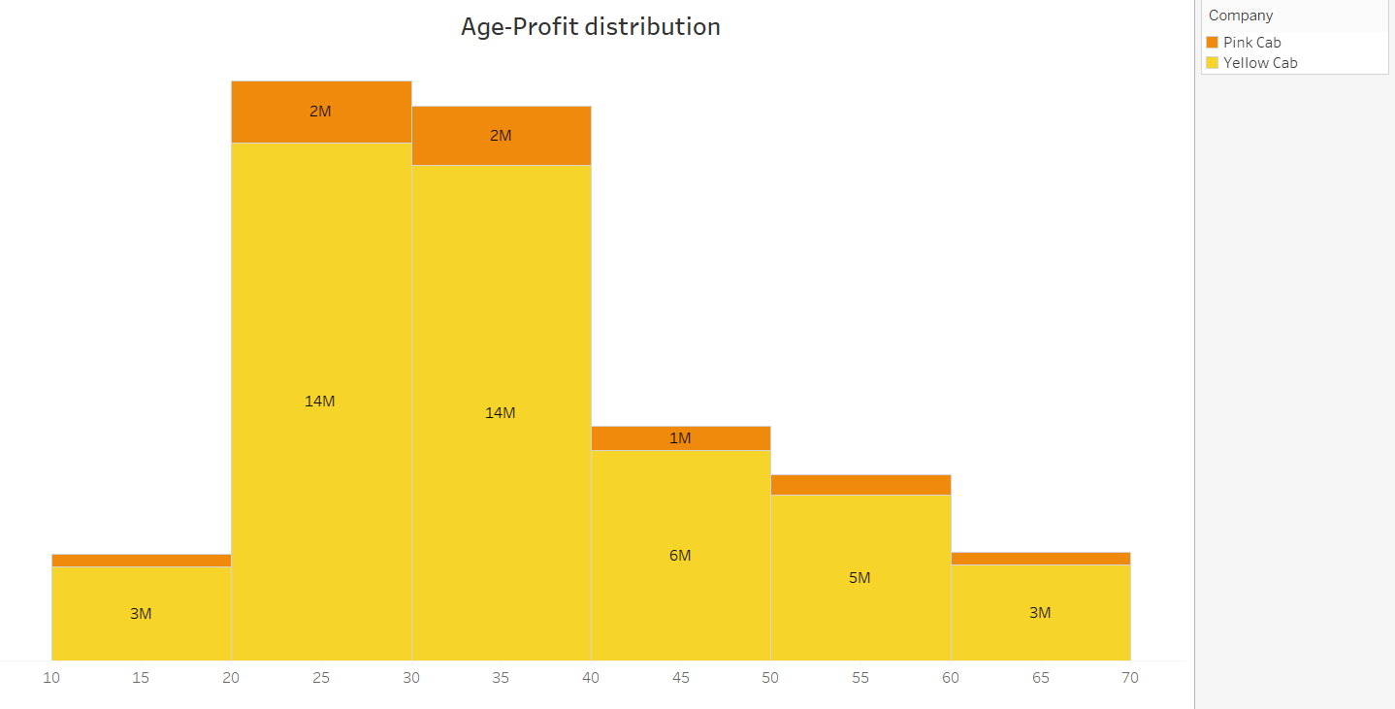
PROFIT BY AGE
Age was divided into six (6) different categories with a minimum age of 18 and a maximum of 65.
The highest profit figures was recorded for ages 20-30, then for ages 30-40.
For each age category, the Yellow cab company dominated the market with profit earnings up to 80% more than their counterparts.

Slide 15
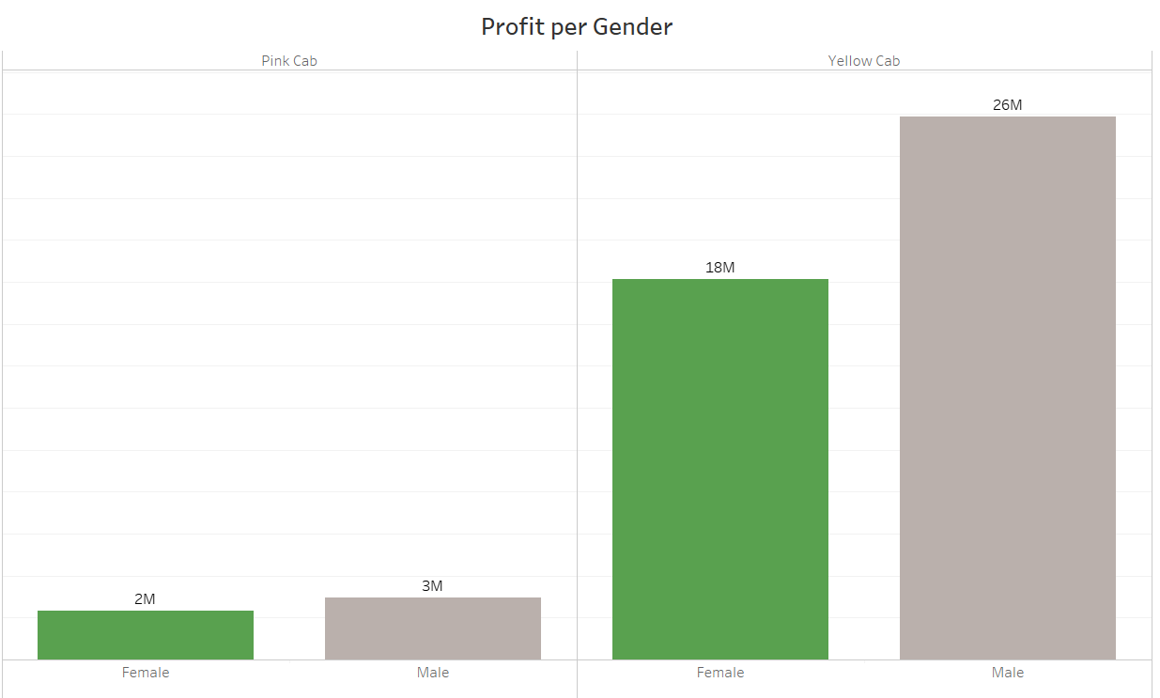
PROFIT-GENDER RELATIONSHIP
Overall, more profit were generated from male trips.
While there was a 33% profit difference between male and female trips for Pink cab trips, there was a 30% difference for Yellow cab trips
A 16 million difference in profit was realized by the yellow cab company for the three (3) years analyzed for female trips. Male trips generated a 23 million difference between both companies.

Slide 16

USER ANALYSIS

Slide 17
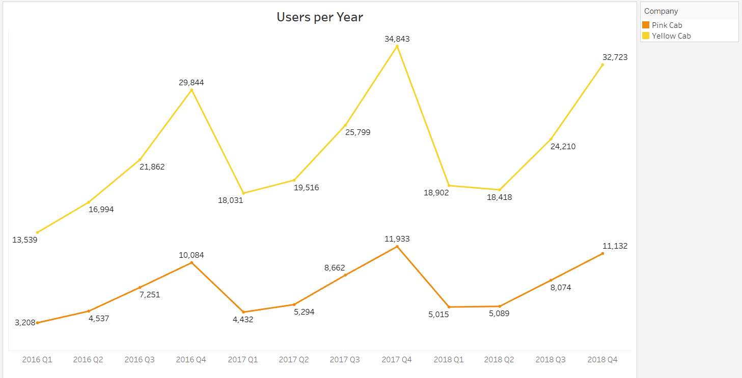
USERS-YEAR ANALYSIS
Similar pattern was noticed for both companies. There was a steady increase in the number of users for each year from the 1st quarter till the 4th quarter followed by a sharp decline in the 1st quarter of the following year.
An exception to the above was noticed for the Yellow cab company with a slight further decline in the 2nd quarter of 2018.
There exist a (66-76)% difference in the number of users for both companies with the Yellow cab company used by more persons.

Slide 18
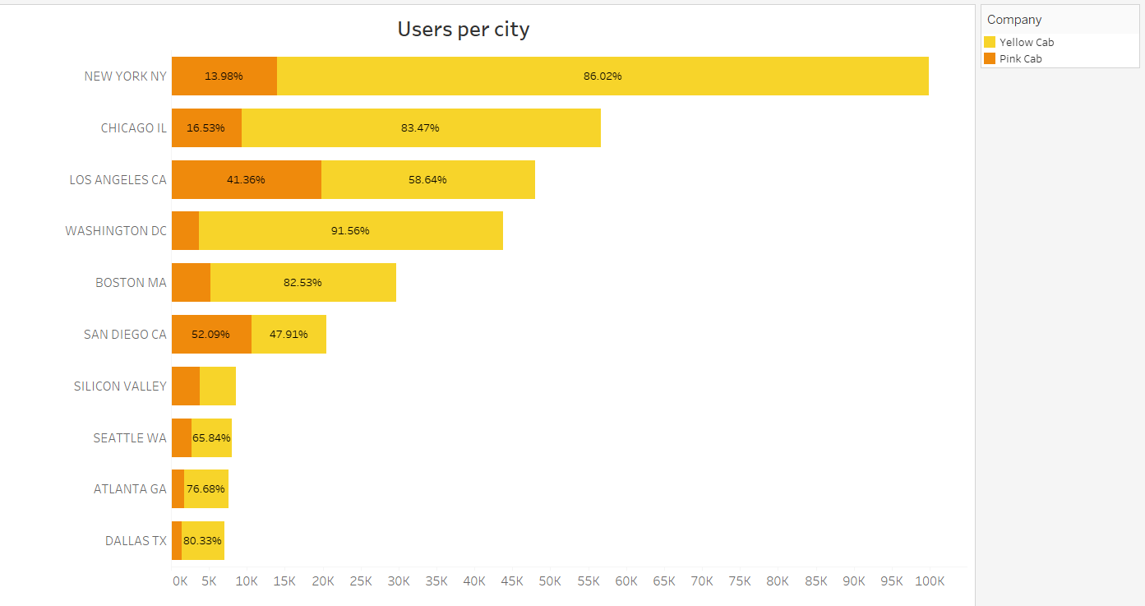
CITY-WISE USERS
Analysis showcasing top ten user cities revealed that seven (7) of those cities had at least 65% more users for the yellow cab company.
San Diego had more Pink cab users.

Slide 19
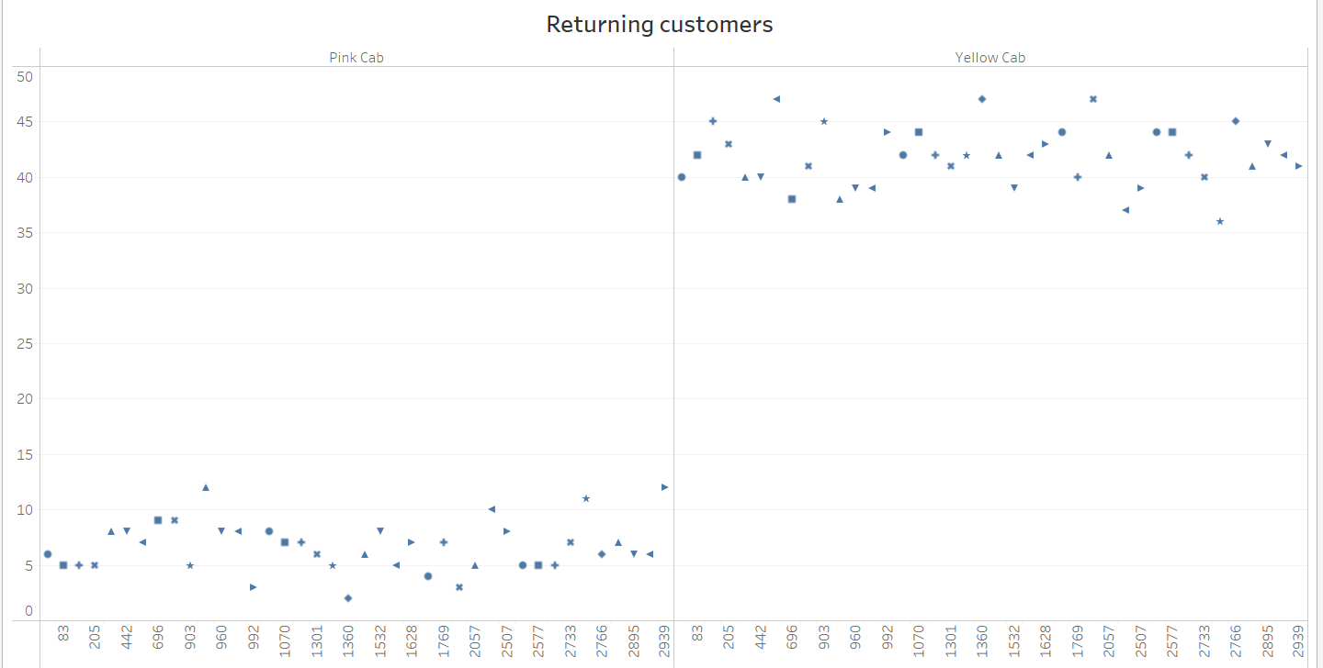
RETURNING CUSTOMERS
By analyzing the overall top 20 users, it was revealed that on an average, returning users took yellow cabs 5 times more than they took pink cabs.

Slide 20
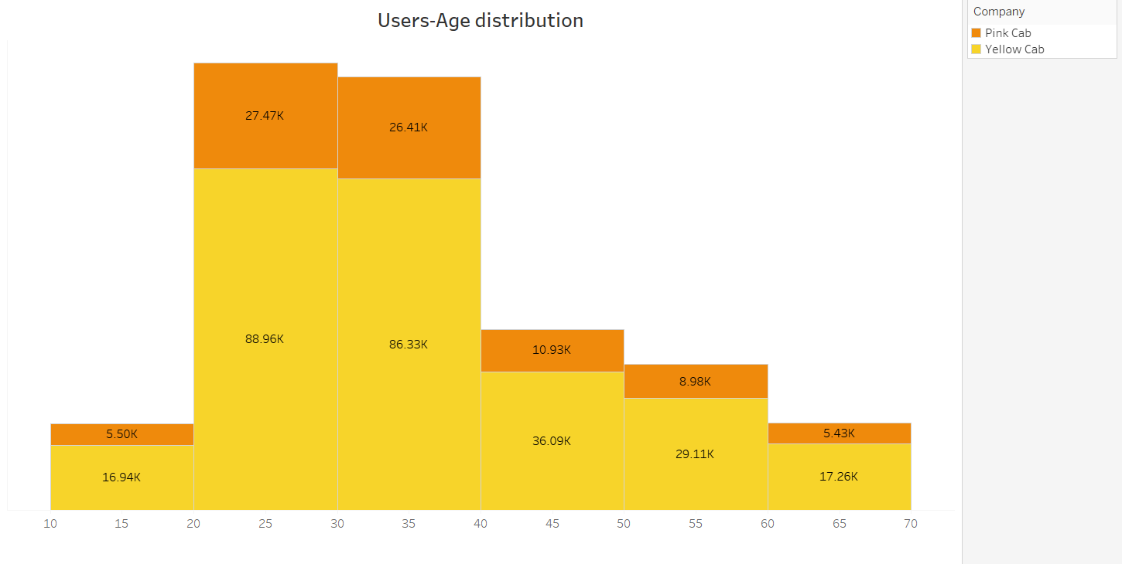
USERS-AGE DISTRIBUTION
The highest number of users ensued from ages 20-30, then for ages 30-40.
For each age category, the Yellow cab company dominated the market with more number of users than their counterparts.

Slide 21
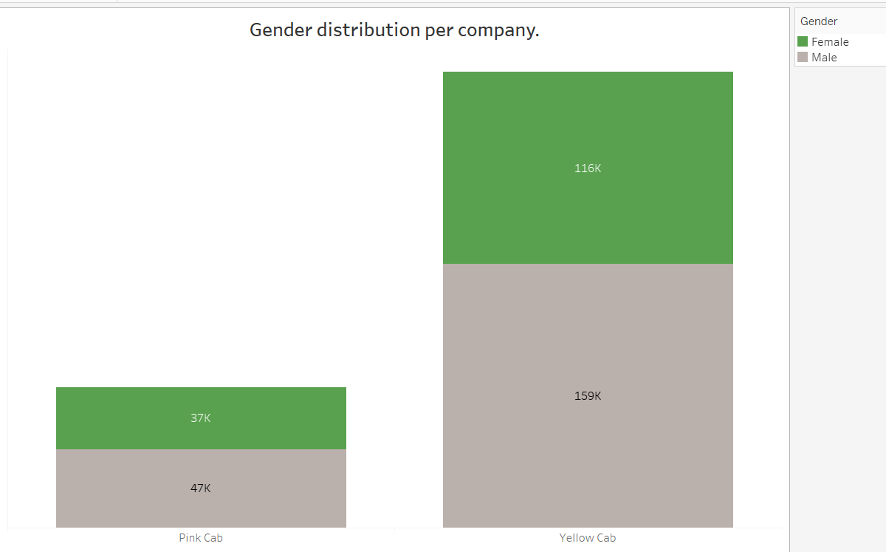
USERS-GENDER DISTRIBUTION
Slight difference exist between the genders for the two companies.
Major difference was obvious for the same gender of the different companies.
Overall, Yellow cab company has more male and female users.

Slide 22

PROFIT & USERS FORECAST

Slide 23
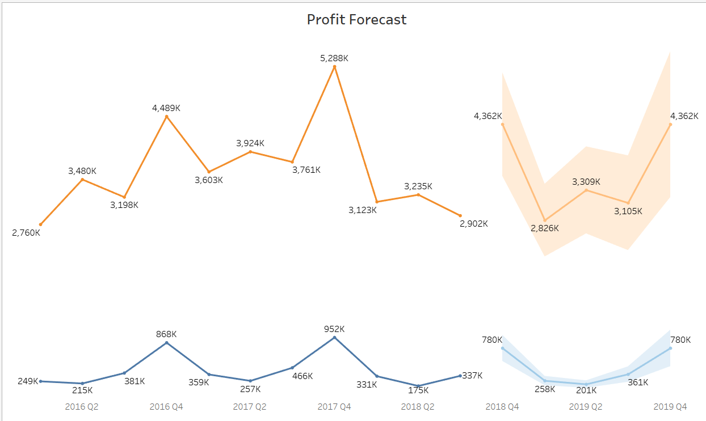
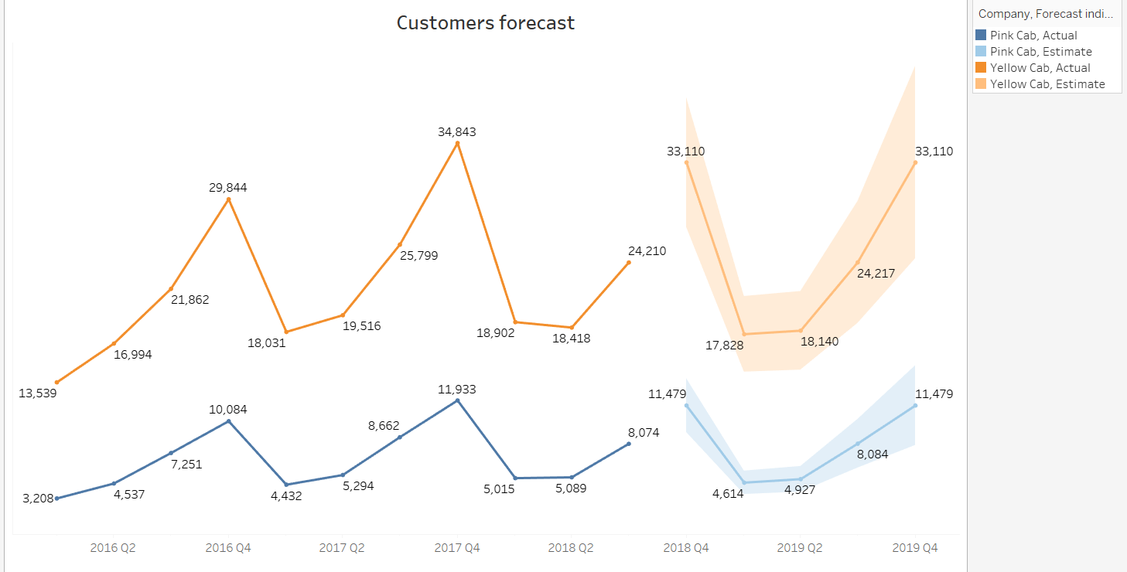

Slide 24
RECOMMENDATIONS
Based on analysis done, it was revealed that the Yellow cab company not only made more profits but also had higher number of users across the different categories analyzed.
Categories include yearly profit and number of users, profit and number of users per city, profit and customer preference across income groups, profit and number of users across different age groups e.t.c.
Its safe to say that the better investment choice is the Yellow cab company

Slide 25
THANK YOU

